Slide 1
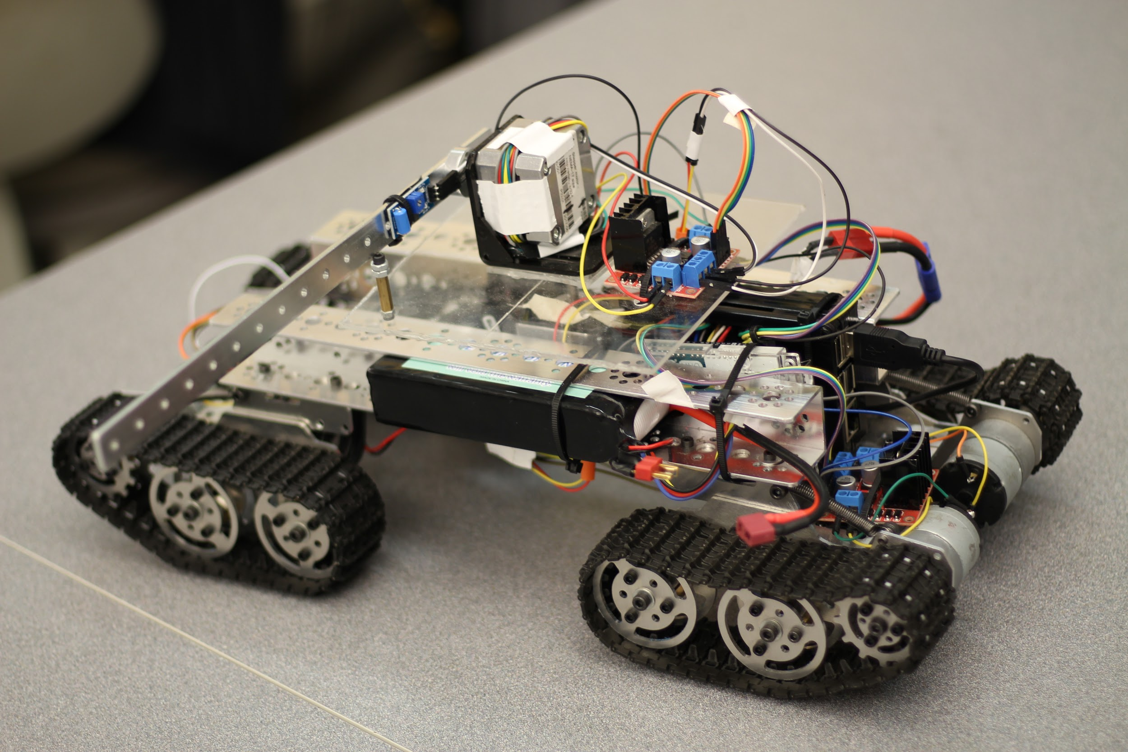
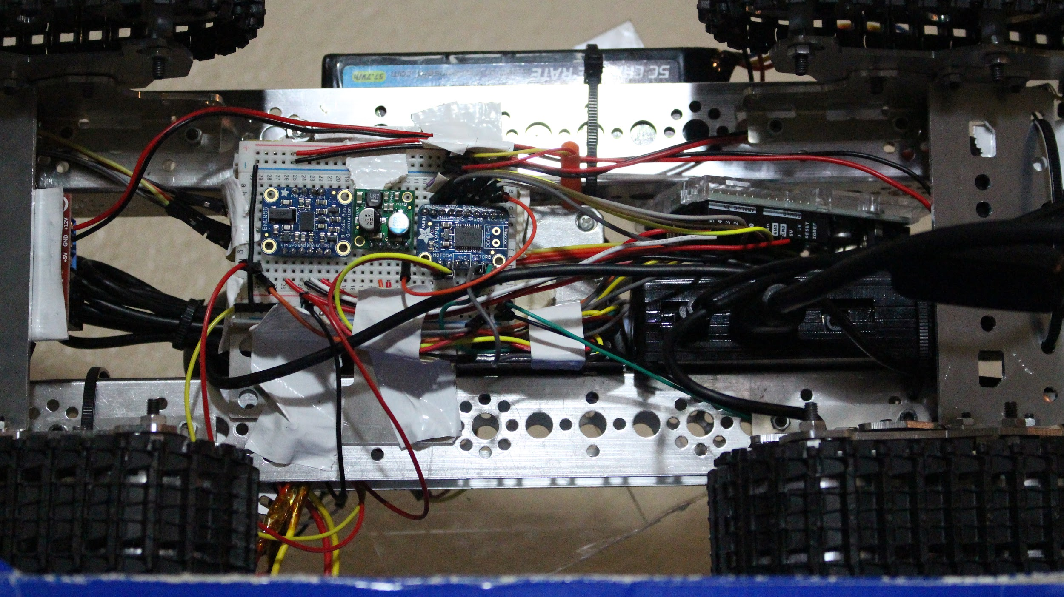
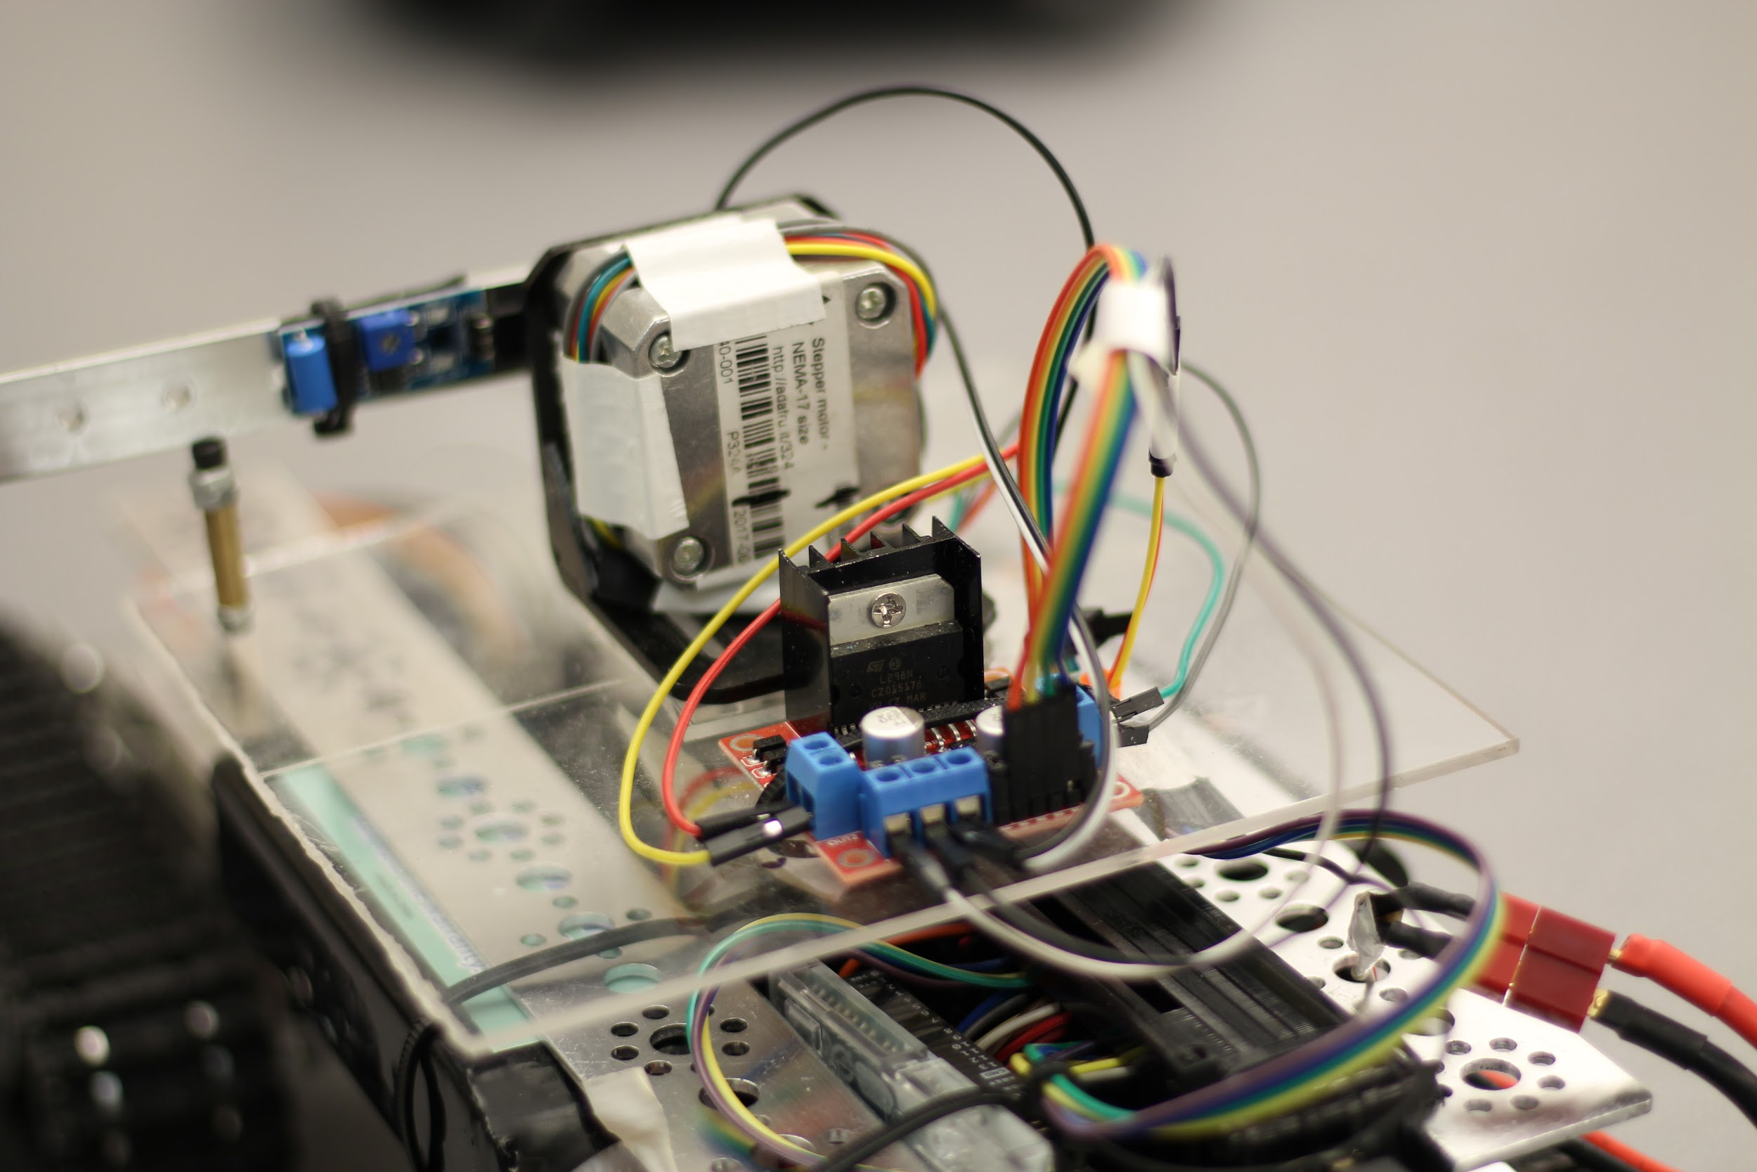
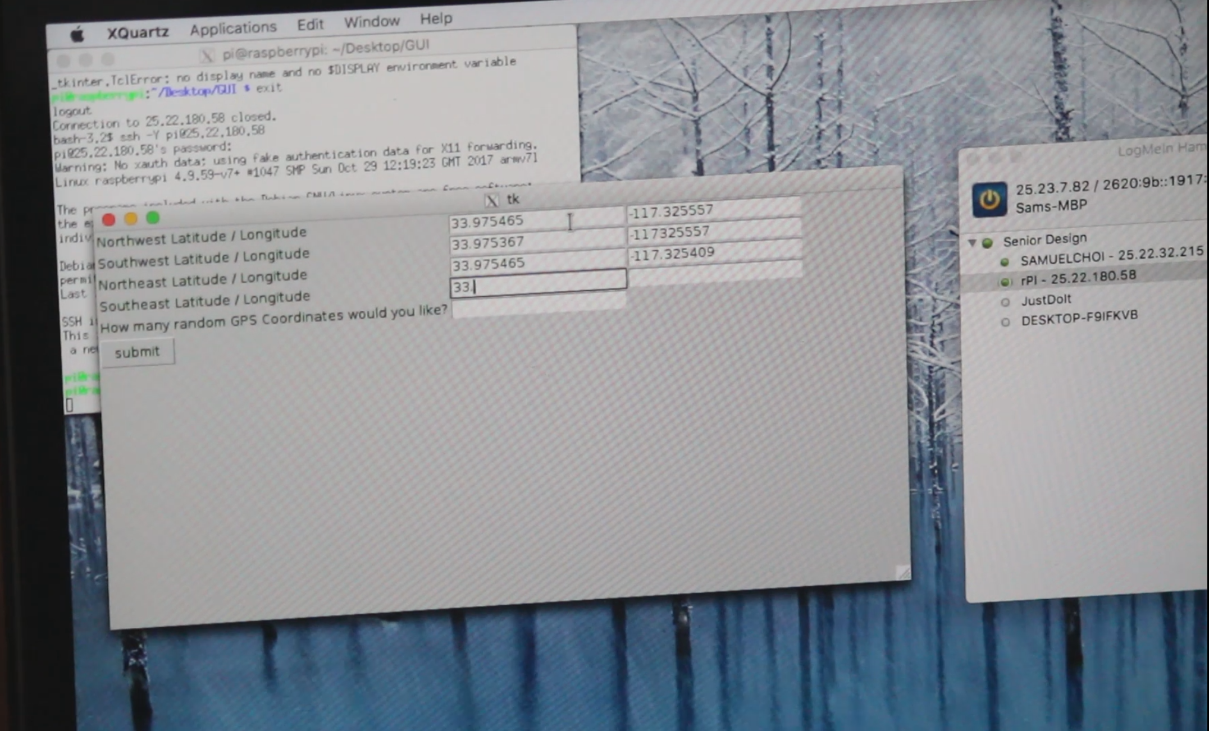
Autonomous Ground Target Vehicle
Taylor Che, Samuel Choi, Francisco Munoz
Project Objective:
Semi Autonomous Rover
Navigation to designated GPS coordinates
Provide target for shooting & confirmation
Communication via Wifi and SSH
Experimental Hardware and Software Setup:
Raspberry Pi 3 Model B
Arduino Uno
Stepper and DC motors
Python
Project Outcomes
Create GPS based boundary
Navigate to n random points within the boundary
Present target at each destination
Record number of hits at each destination
Return to origin after arriving at all destinations

